Slide 1

Taylor Insurance System
Software developed by MERGABYTE.
Jason Somerton-Earle
John-Michael Woodrow
Lucas Maloney
Patrick Rideout

Slide 2
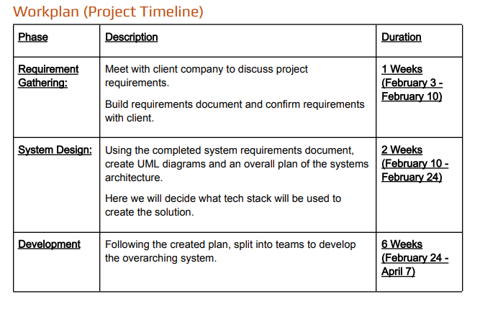
Planning & Overview
Client: Taylor Insurance - Insurance Provider
Goal: Modernize customer experience
Solution: Web platform
Timeline:
Requirements: Feb 3-10
Design: Feb 10-24
Development: Feb 24- Apr 7
Testing: Apr 7- Apr 16

Slide 3
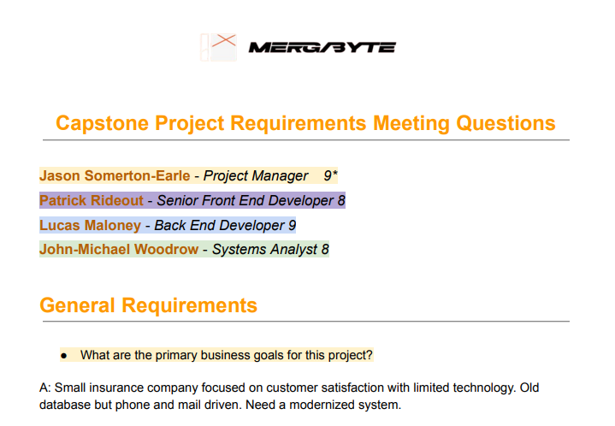
Documentation & Requirements
Documentation gathered via call for interest and interviews which resulted in the system proposal
Core Requirements Defined:
Login and profile management
Quoting, Policy development and logic
Admin access
Constraints Defined:
SQL compliant
Mobile and accessible design
etc

Slide 4
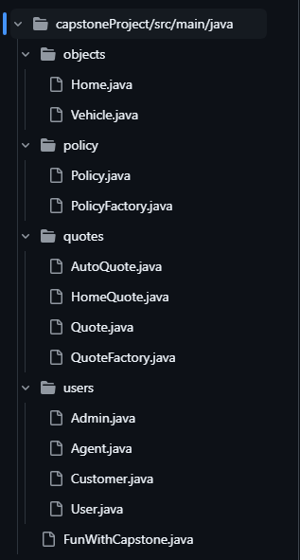
Initial Design
Standard Java classes (Plain Old Java Objects):
User, Customer, Policy, Quote, HomeQuote, Home, etc
Manual relationship handling between users and policies/quotes
Class, activity and state diagrams guided design

Slide 5
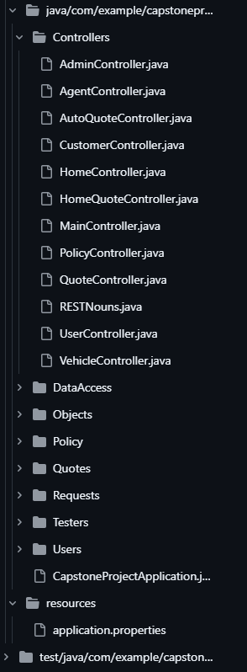
Transition to Spring Boot & REST
Switched to Spring Boot for scalable API design
REST endpoints for all major features:
Users, Policies, Quotes, etc
Spring Annotations used for routing and data handling
JPA + Repository pattern replaced manual database handling

Slide 6
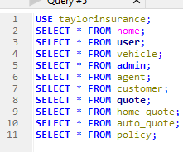
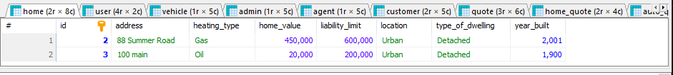
Backend Finished Product
Built entirely in Spring Boot
REST API returns and receives JSON objects
Uses
@Entity, @Controller, @repository, @Service, etc
MariaDB for persistent storage
Quotes use rating factors to calculate total premiums

Slide 7
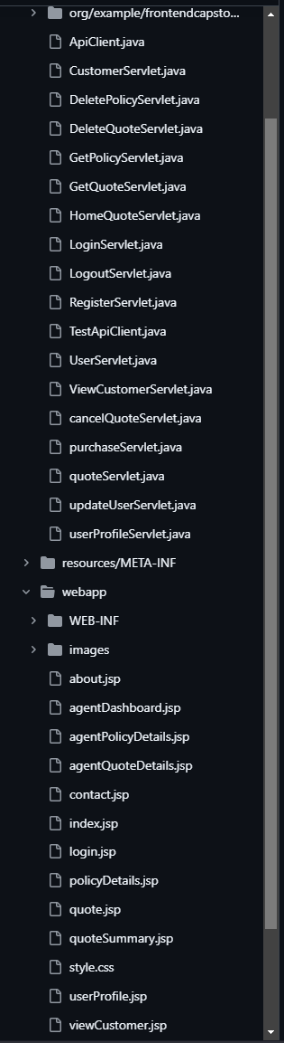

Frontend Technology
Lightweight, mobile friendly web UI
Built with:
HTML, CSS, JSP
REST API calls
OkHTTP Library

Slide 8

Frontend Design
Features:
Registration and login
Dynamic quoting for home and auto
Policy viewer
Functioning agent accounts
Stylized with a personal touch 😉

Slide 9
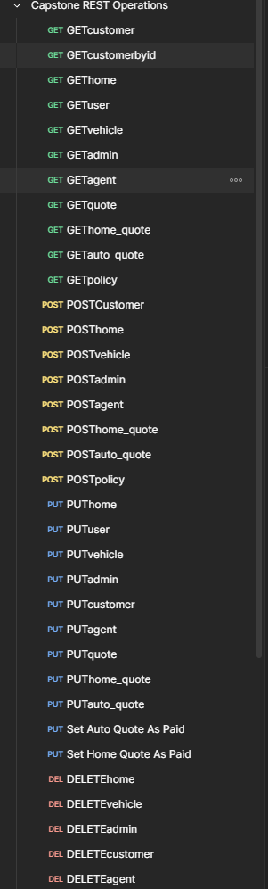
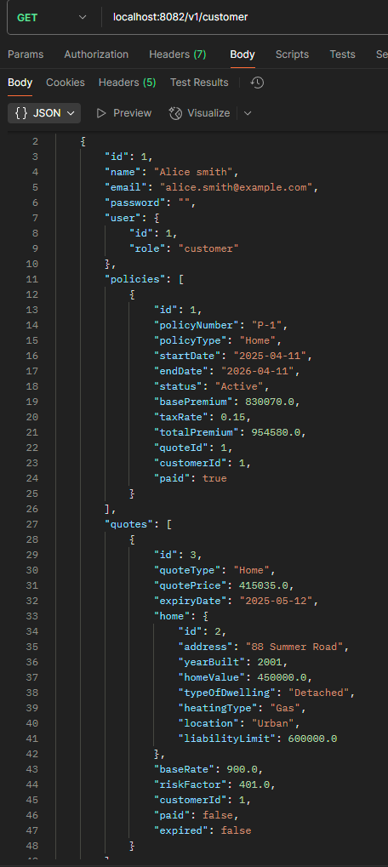
Challenges & solutions
Initial issues with properly handling front to backend API calls
Discussion lead to Postman testing which resolved these issues
Clean separation of front and back end means easier updates

Slide 10
Final Summary
Clean user friendly website for Taylor Insurance
RESTful backend supporting full customer policy lifecycle
Admin features to view and manage reports

